Slide 1
Notes:
#0 - BLANK BACKGROUND

Slide 2
Notes:
#1 - TITLE: “GIVING LEADERSHIP AWAY”

Slide 3
“The greatest challenge for team leaders is to let go of their work.”
Notes:
#2 – QUOTE: “The greatest challenge for team leaders is to let go of their work.”

Slide 4
CHARACTERISTICS OF AN INSPIRATIONAL LEADER
Notes:
#3 – Characteristics of an Inspirational Leader

Slide 5
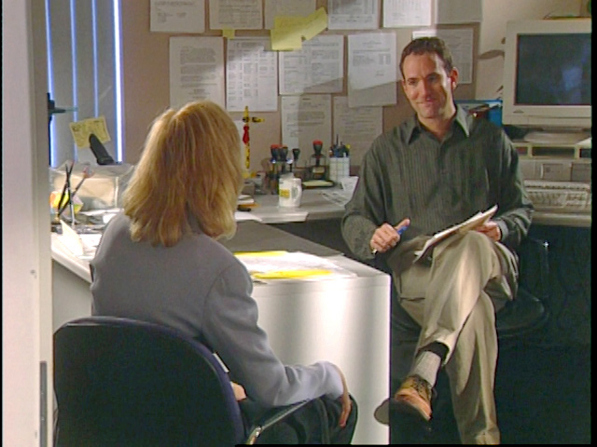
“How come you’ve got all the good people and I’ve got all the losers?”
- Linda, Giving Leadership Away
Notes:
#4 – QUOTE: “How come you’ve got all the good people and I’ve got all the losers?”
- Linda, Giving Leadership Away

Slide 6
KEY POINTS
Notes:
#5A: KEY POINTS

Slide 7
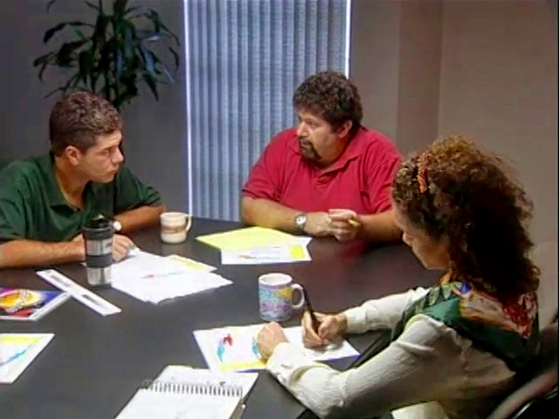
KEY POINTS
1. ESTABLISH COMMON GOALS
Notes:
#5B 1. ESTABLISH COMMON GOALS

Slide 8
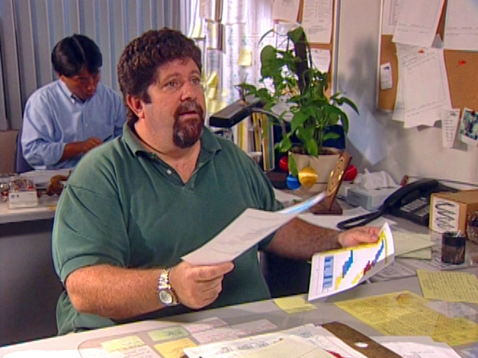
KEY POINTS
1. ESTABLISH COMMON GOALS
2. ALLOW PEOPLE TO DO
THEIR JOBS
Notes:
#5C: 2. ALLOW PEOPLE TO DO THEIR JOBS

Slide 9
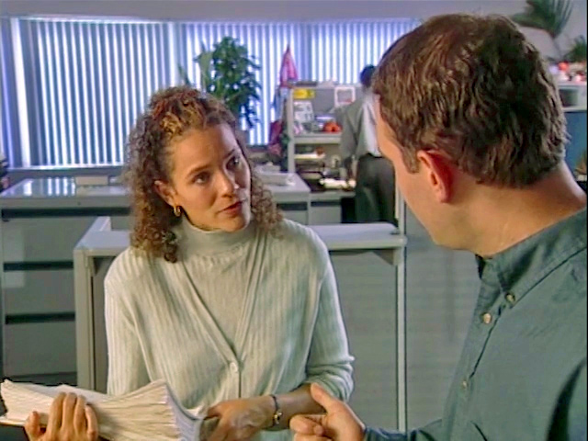
KEY POINTS
1. ESTABLISH COMMON GOALS
2. ALLOW PEOPLE TO DO
THEIR JOBS
3. AGREE ON LEVELS OF RESPONSIBILITY
Notes:
#5D: 3. AGREE ON LEVELS OF RESPONSIBILITY

Slide 10
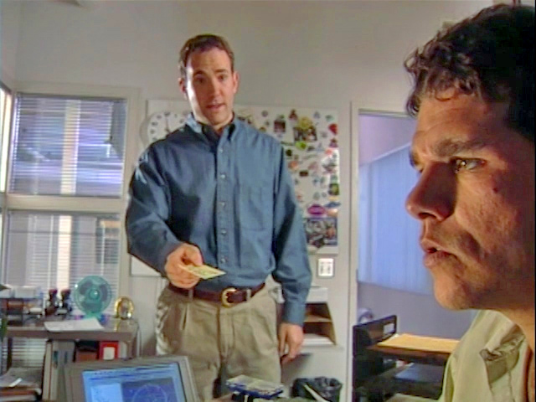
KEY POINTS
1. ESTABLISH COMMON GOALS
2. ALLOW PEOPLE TO DO
THEIR JOBS
3. AGREE ON LEVELS OF RESPONSIBILITY
4. HOLD PEOPLE ACCOUNTABLE
Notes:
#5E: 4. HOLD PEOPLE ACCOUNTABLE

Slide 11
KEY POINTS
1. ESTABLISH COMMON GOALS
2. ALLOW PEOPLE TO DO
THEIR JOBS
3. AGREE ON LEVELS OF RESPONSIBILITY
4. HOLD PEOPLE ACCOUNTABLE
5. KEEP TEAM FOCUSED ON GOALS
Notes:
#5F: 5. KEEP TEAM FOCUSED ON GOALS

Slide 12
Notes:
#6 - TITLE: “GIVING LEADERSHIP AWAY”

Slide 13
Notes:
#7 - BLANK BACKGROUND

