Slide 1
Notes:
#0 - BLANK BACKGROUND

Slide 2
Hire For
Attitude
Notes:
#1 - TITLE: “HIRE FOR ATTITUDE”

Slide 3
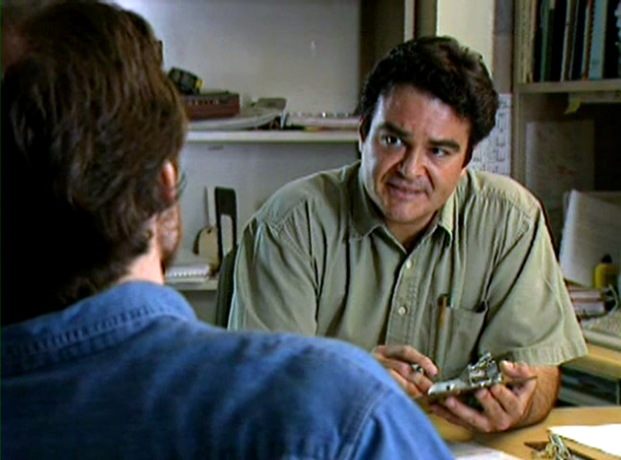
The most common – and fatal – hiring mistake is to find someone with the right skills but the wrong mind-set and hire them on the theory, “We can change ‘em.”
- Fast Company Magazine
Notes:
#2 - QUOTE: “The most common—and fatal—hiring mistake is to find someone with the right skills but the wrong mind-set and hire them on the theory, “We can change ‘em.” - Fast Company Magazine

Slide 4
Conduct a Structured Interview
Notes:
#3A – LIST: Conduct a Structured Interview

Slide 5
Conduct a Structured Interview
1. Set up an appropriate time
and place
Notes:
#3B – LIST: 1. Set up an appropriate time and place

Slide 6
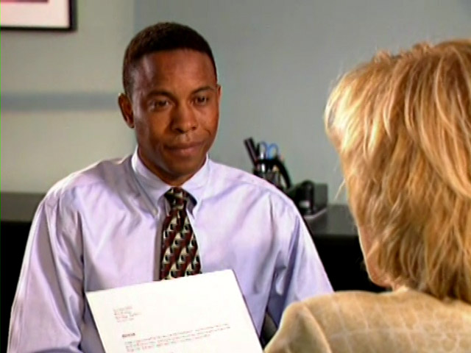
Conduct a Structured Interview
1. Set up an appropriate time
and place
2. Review skills and experience
Notes:
#3C – LIST: 2. Review skills and experience

Slide 7
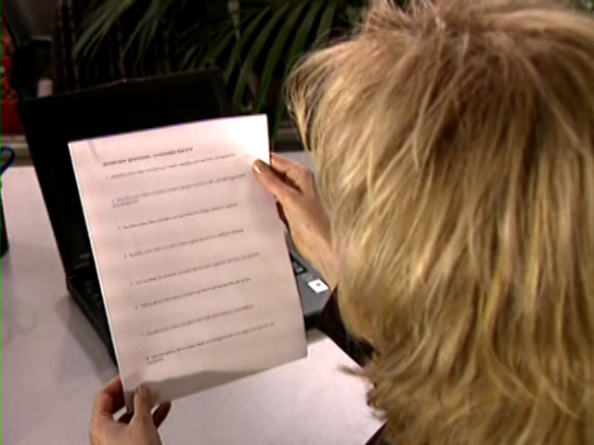
Conduct a Structured Interview
1. Set up an appropriate time
and place
2. Review skills and experience
3. Ask each applicant the same,
prepared questions
Notes:
#3D – LIST: 3. Ask each applicant the same, prepared questions

Slide 8
Conduct a Structured Interview
1. Set up an appropriate time
and place
2. Review skills and experience
3. Ask each applicant the same,
prepared questions
4. Request specific answers
Notes:
#3E – LIST: 4. Ask specific questions

Slide 9
Conduct a Structured Interview
1. Set up an appropriate time
and place
2. Review skills and experience
3. Ask each applicant the same,
prepared questions
4. Request specific answers
5. Allow time for thinking
Notes:
#3F – LIST: 5. Allow time for thinking

Slide 10
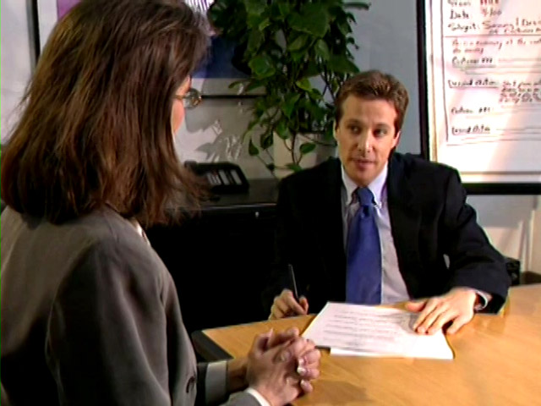
Conduct a Structured Interview
1. Set up an appropriate time
and place
2. Review skills and experience
3. Ask each applicant the same,
prepared questions
4. Request specific answers
5. Allow time for thinking
6. Keep the interview on track
Notes:
#3G – LIST: 6. Keep the interview on track

Slide 11
It’s much easier to teach job skills than
to teach personal integrity and character.
- Credit Union Executive
Notes:
#4 - QUOTE: It’s much easier to teach job skills than to teach personal integrity and character. - Credit Union Executive

Slide 12
Hire For
Attitude
Notes:
#5 - TITLE: “HIRE FOR ATTITUDE”

Slide 13
Notes:
#6 - BLANK BACKGROUND

