Slide 1
Notes:
SLIDE #0: Blank Background

Slide 2
Notes:
SLIDE #1 - Title: “Leading with Persuasion”

Slide 3
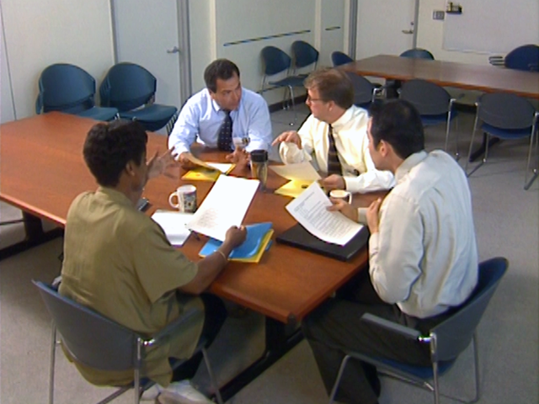
If you would convince others, seem open to conviction yourself.
- Lord Chesterfield
Notes:
SLIDE #2: “If you would convince others, seem open to conviction yourself.” - Lord Chesterfield

Slide 4
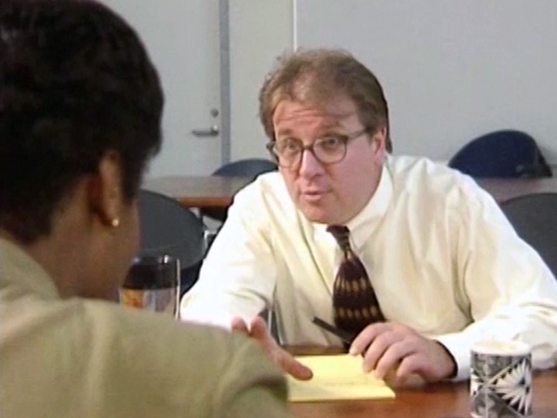
We often refuse to
accept an idea merely because the tone of
voice in which it has
been expressed is unsympathetic to us. - Friedrich Wilhelm Nietzche
Notes:
SLIDE #3: “We often refuse to accept an idea merely because the tone of voice in which it has been expressed is unsympathetic to us.” - Friedrich Wilhelm Nietzche

Slide 5
Prepare for Persuasion
Notes:
SLIDE #4A: Prepare for Persuasion

Slide 6
Prepare for Persuasion
• Recognize your own value
Notes:
SLIDE #4B: • Recognize your own value

Slide 7
Prepare for Persuasion
• Recognize your own value
• Focus your idea into one
simple sentence
Notes:
SLIDE #4C: • Focus your idea into one simple sentence

Slide 8
Prepare for Persuasion
• Recognize your own value
• Focus your idea into one
simple sentence
• Support your idea with solid
evidence
Notes:
SLIDE #4D: • Support your idea with solid evidence

Slide 9
Prepare for Persuasion
• Recognize your own value
• Focus your idea into one
simple sentence
• Support your idea with solid
evidence
• Anticipate objections
Notes:
SLIDE #4E: • Anticipate objections

Slide 10
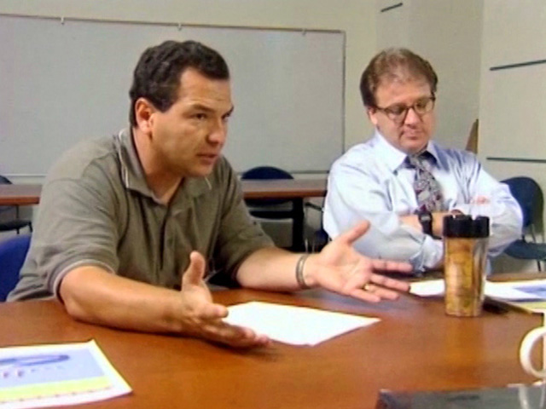
Present with Confidence
Notes:
SLIDE #5A: Present with Confidence

Slide 11
Present with Confidence
• Establish your credibility
Notes:
SLIDE #5B: • Establish your credibility

Slide 12
Present with Confidence
• Establish your credibility
• Be direct and logical
Notes:
SLIDE #5C: • Be direct and logical

Slide 13
Present with Confidence
• Establish your credibility
• Be direct and logical
• Show conviction
Notes:
SLIDE #5D: • Show conviction

Slide 14
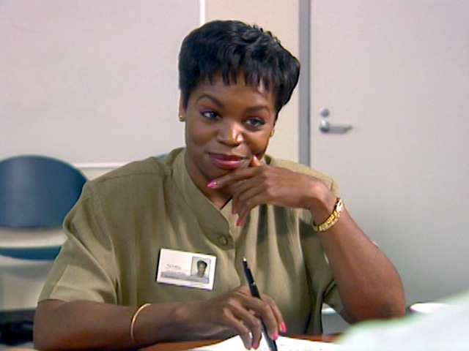
Active Listening Skills
Notes:
SLIDE #6A: Active Listening Skills

Slide 15
Active Listening Skills
1. Summarize the speaker’s
statements - both factual and
emotional
Notes:
SLIDE #6B: 1. Summarize the speaker’s statements - both factual and emotional.

Slide 16
Active Listening Skills
1. Summarize the speaker’s
statements - both factual and
emotional
2. Ask questions
Notes:
SLIDE #6C: 2. Ask questions

Slide 17
Active Listening Skills
1. Summarize the speaker’s
statements - both factual and
emotional
2. Ask questions
3. Don’t let your own emotions
get in the way of listening
Notes:
SLIDE #6D: 3. Don’t let your own emotions get in the way of listening

Slide 18
Active Listening Skills
1. Summarize the speaker’s
statements - both factual and
emotional
2. Ask questions
3. Don’t let your own emotions
get in the way of listening
4. Use verbal and nonverbal
cues to show that you are
listening
Notes:
SLIDE #6E: 4. Use verbal and nonverbal cues to show that you are listening

Slide 19
Respond to Emotional Issues
Notes:
SLIDE #7A: Respond to Emotional Issues

Slide 20
Respond to Emotional Issues
• Talk to people one on one
Notes:
SLIDE #7B: • Talk to people one on one

Slide 21
Respond to Emotional Issues
• Talk to people one on one
• Be prepared to listen
Notes:
SLIDE #7C: • Be prepared to listen

Slide 22
Respond to Emotional Issues
• Talk to people one on one
• Be prepared to listen
• Consider compromise
Notes:
SLIDE #7D: • Consider compromise

Slide 23
Nothing is so contagious as enthusiasm.
- Samuel Coleridge
Notes:
SLIDE #8A: “Nothing is so contagious as enthusiasm.” - Samuel Coleridge

Slide 24
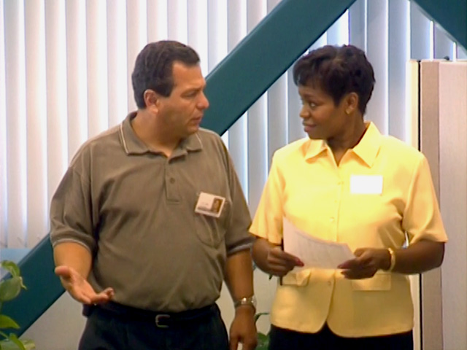
Effective persuasion requires enthusiasm grounded in conviction.
- John Baldoni - from
“Leadership As Salesmanship”
Notes:
SLIDE #8B: “Effective persuasion requires enthusiasm grounded in conviction.” - John Baldoni from “Leadership As Salesmanship”

Slide 25
Notes:
SLIDE #9 - Title: “Leading with Persuasion”

Slide 26
Notes:
SLIDE #10: Blank Background

