Slide 1
Notes:
SLIDE #0 - Blank Background

Slide 2
Notes:
SLIDE #1 - Title: “Would I Inspire Me?”

Slide 3
Leaders can and do inspire people to perform at a high level on a regular basis.
- Robin Fielder,
Inspirational Leadership Management Course
Notes:
SLIDE #2A – “Leaders can and do inspire people to perform at a high level on a regular basis.” - Robin Fielder, Inspirational Leadership Management Course

Slide 4
Leaders who develop purposeful relationships are more likely to inspire greater productivity, innovation, and overall employee performance.
- “Grace at Work” TD
Notes:
SLIDE #2B – “Leaders who develop purposeful relationships are more likely to inspire greater productivity, innovation, and overall employee performance.” - “Grace at Work” TD March, 2006

Slide 5
When workers know their work makes a difference, productivity rises and so
does job satisfaction.
- Psychology Today, “Making A Difference at Work”
Notes:
SLIDE #3A – “When workers know their work makes a difference, productivity rises and so does job satisfaction.” - Psychology Today, “Making A Difference at Work”

Slide 6
The generation entering the workplace today expects to have meaning in their jobs… What they really want is to
know that what they do matters.
- Business Week, “The Art of Motivation”
Notes:
SLIDE #3B – “The generation entering the workplace today expects to have meaning in their jobs… What they really want is to know that what they do matters.” - Business Week, “The Art of Motivation” May 1, 2006

Slide 7
…I would say that I managed people. I made sure they did the job they were hired to do. Elliot inspired people. And
inspired people are more motivated and more productive.
- “Would I Inspire Me?” video
Notes:
SLIDE #4 – “…I would say that I managed people. I made sure they did the job they were hired to do. Elliot inspired people. And inspired people are more motivated and more productive.” - “Would I Inspire Me?” video

Slide 8
HOW TO INSPIRE YOUR WORK GROUP
Notes:
SLIDE #5A – HOW TO INSPIRE YOUR WORK GROUP

Slide 9
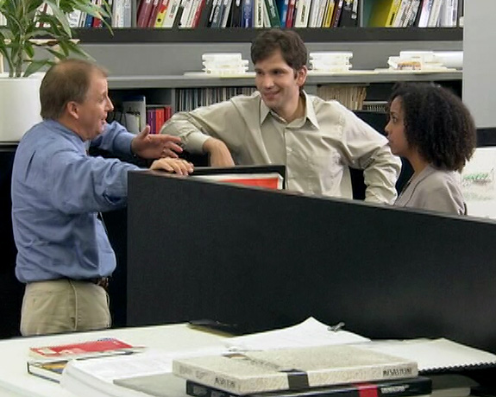
HOW TO INSPIRE YOUR WORK GROUP
- Communicate why the
work is important
Notes:
SLIDE #5B - Communicate why the work is important

Slide 10
HOW TO INSPIRE YOUR WORK GROUP
- Communicate why the
work is important > Use real world examples
Notes:
SLIDE #5C - Communicate why the work is important > Use real world examples

Slide 11
HOW TO INSPIRE YOUR WORK GROUP
- Communicate why the
work is important > Use real world examples > Express genuine enthusiasm
Notes:
SLIDE #5D - Communicate why the work is important > Express genuine enthusiasm

Slide 12
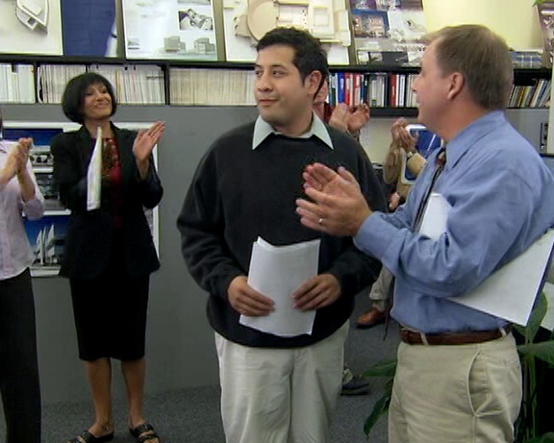
HOW TO INSPIRE YOUR WORK GROUP
- Acknowledge the
contribution of
every employee
Notes:
SLIDE #5E - Acknowledge the contribution of every employee

Slide 13
HOW TO INSPIRE YOUR WORK GROUP
- Acknowledge the
contribution of
every employee
> Look for reasons to
praise people
Notes:
SLIDE #5F - Acknowledge the contribution of every employee > Look for reasons to praise people

Slide 14
HOW TO INSPIRE YOUR WORK GROUP
- Acknowledge the
contribution of
every employee
> Look for reasons to
praise people
> Convey accomplishments to both co-workers &
superiors
Notes:
SLIDE #5G - Acknowledge the contribution of every employee > Convey accomplishments to both co-workers & superiors

Slide 15
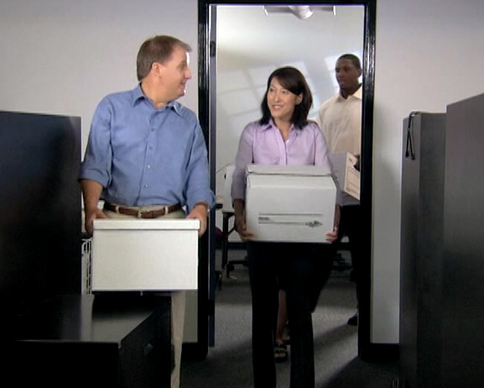
HOW TO INSPIRE YOUR WORK GROUP
- Support your team
Notes:
SLIDE #5H - Support your team

Slide 16
HOW TO INSPIRE YOUR WORK GROUP
- Support your team
> Pitch in as a team member
Notes:
SLIDE #5I - Support your team > Pitch in as a team member

Slide 17
HOW TO INSPIRE YOUR WORK GROUP
- Support your team
> Pitch in as a team member
> Remove obstacles to
success
Notes:
SLIDE #5J - Support your team > Remove obstacles to success

Slide 18
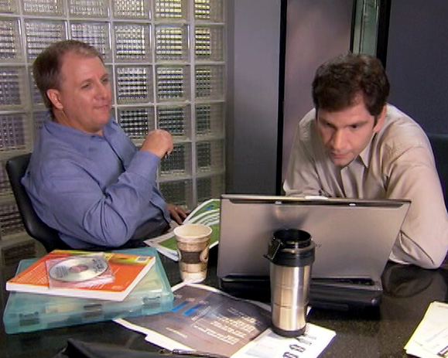
HOW TO INSPIRE YOUR WORK GROUP
- Create opportunities for growth
Notes:
SLIDE #5K - Create opportunities for growth

Slide 19
HOW TO INSPIRE YOUR WORK GROUP
- Create opportunities for growth
> Go beyond job descriptions
Notes:
SLIDE #5L - Create opportunities for growth > Go beyond job descriptions

Slide 20
HOW TO INSPIRE YOUR WORK GROUP
- Create opportunities for growth
> Go beyond job descriptions
> Be aware of people’s goals
Notes:
SLIDE #5M - Create opportunities for growth > Be aware of people’s goals

Slide 21
Before I can hope to inspire anybody else, first I’ve got to inspire me.
- “Would I Inspire Me?” video
Notes:
SLIDE #6 – “Before I can hope to inspire anybody else, first I’ve got to inspire me.” - “Would I Inspire Me?” video

Slide 22
Creating self-respect and a sense of excitement is what it is all about.
- Robin Fielder,
Inspirational Leadership Management Course
Notes:
SLIDE #7A – “Creating self-respect and a sense of excitement is what it is all about.” - Robin Fielder, Inspirational Leadership Management Course

Slide 23
The way to get things done is by injecting enthusiasm and energy.
- Changing Minds.org / Transformational Leadership
Notes:
SLIDE #7B – “The way to get things done is by injecting enthusiasm and energy.” - Changing Minds.org / Transformational Leadership

Slide 24
Notes:
SLIDE #8 - Title: “Would I Inspire Me?

Slide 25
Notes:
Blank Background

