Slide 1

Notes:
#0 - BLANK BACKGROUND

Slide 2
You’ve
Got
Customers!
And They Want Action!
Notes:
#1 - TITLE: “You’ve Got Customers!”

Slide 3
CUSTOMER SERVICE SURVEY
_____ COMPETENT (Knows product or service)
_____ HONEST
_____ POLITE
_____ CHEERFUL
_____ GOOD SPEAKER
_____ GOOD LISTENER
_____ FOLLOWS THROUGH ON REQUESTS
_____ TAKES INITIATIVE TO SOLVE PROBLEMS
_____ INFORMATIVE (Gives useful information)
_____ TRAIT NOT LISTED (Optional)
Notes:
#2 – CUSTOMER SERVICE SURVEY

Slide 4

“SERVICE BEYOND A SMILE”
Notes:
#3 – “SERVICE BEYOND A SMILE”

Slide 5
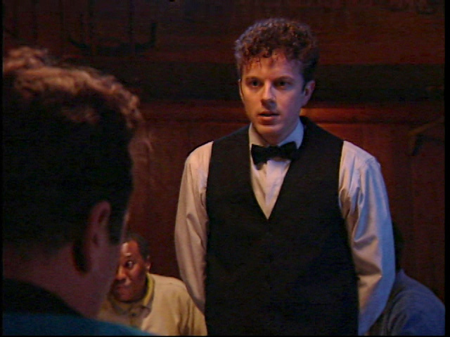
“SERVICE BEYOND A SMILE”
1. Be honest
Notes:
#3A – 1. Be honest

Slide 6
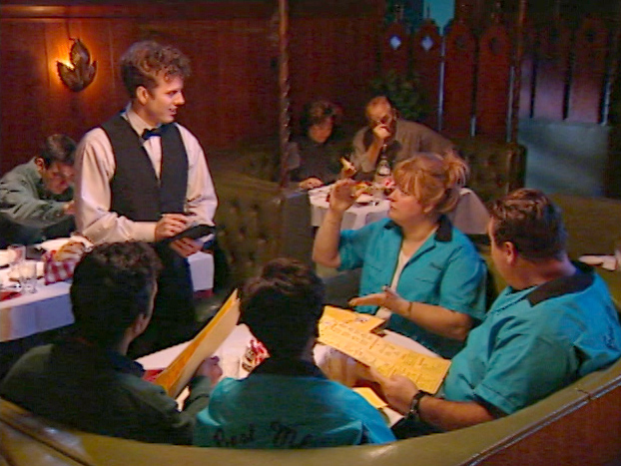
“SERVICE BEYOND A SMILE”
1. Be honest
2. Listen Before You Sell
Notes:
#3B – 2. Listen Before You Sell

Slide 7
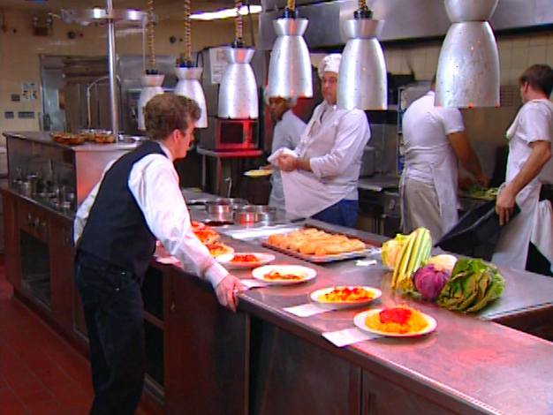
“SERVICE BEYOND A SMILE”
1. Be honest
2. Listen Before You Sell
3. Follow Through on Customer Requests
Notes:
#3C – 3. Follow Through on Customer Requests

Slide 8
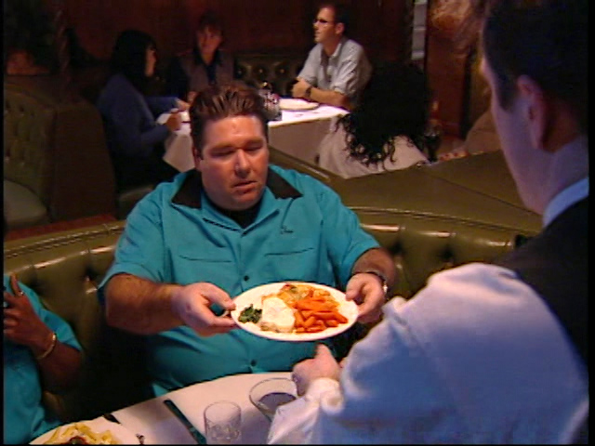
“SERVICE BEYOND A SMILE”
1. Be honest
2. Listen Before You Sell
3. Follow Through on Customer Requests
4. Take Initiative to Solve Problems
Notes:
#3D – 4. Take Initiative to Solve Problems

Slide 9
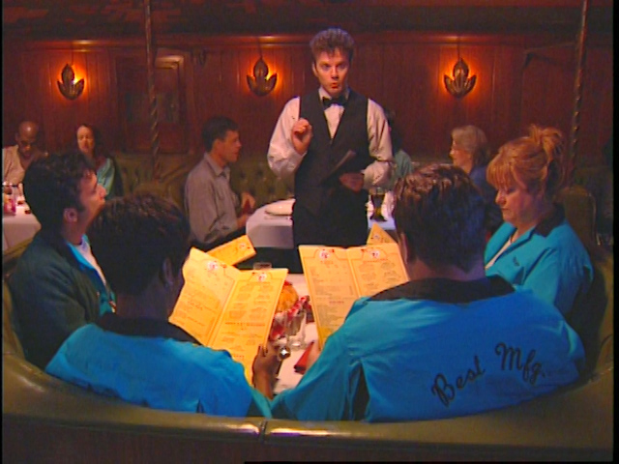
“SERVICE BEYOND A SMILE”
1. Be honest
2. Listen Before You Sell
3. Follow Through on Customer Requests
4. Take Initiative to Solve Problems
5. Know Your Product
Notes:
#3E – 5. Know Your Product

Slide 10
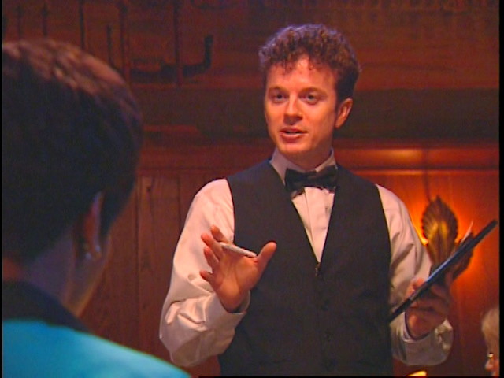
“SERVICE BEYOND A SMILE”
1. Be honest
2. Listen Before You Sell
3. Follow Through on Customer Requests
4. Take Initiative to Solve Problems
5. Know Your Product
6. Take Advantage of Sales Opportunities
Notes:
#3F – 6. Take Advantage of Sales Opportunities

Slide 11
Notes:
#4 – BLANK SLIDE

Slide 12
Michael:
“But that’s not my fault.”
Notes:
#4A – Michael: “But that’s not my fault.”

Slide 13
Michael:
“But that’s not my fault.”
Luigi:
“Maybe not. But the customer is only talking to one person. You. To them, you are the business. They want you to make sure it not only goes in right, but that it comes out right.”
Notes:
#4B - Luigi: “Maybe not. But the customer is only talking to one person. You. To them, you are the business. They want you to make sure it not only goes in right, but that it comes out right.”

Slide 14
Notes:
#5 – BLANK SLIDE

Slide 15
“The buck stops here.”
Notes:
#5A - “The buck stops here.”

Slide 16
“The buck stops here.”
- HARRY TRUMAN,
handwritten sign on
White House desk
Notes:
#5B - HARRY TRUMAN, handwritten sign on White House desk

Slide 17
Notes:
#6 – BLANK SLIDE

Slide 18
Good service isn’t about flowery words and pleasant smiles…
Notes:
#6A – Good service isn’t about flowery words and pleasant smiles…

Slide 19
Good service isn’t about flowery words and pleasant smiles… It’s about actions.
Notes:
#6B – It’s about actions.

Slide 20
You’ve
Got
Customers!
And They Want Action!
Notes:
#7 - TITLE: “You’ve Got Customers!”

Slide 21
Notes:
#8 – BLANK SLIDE

